Slide 1
Dev Center - Update
Weekly Leadership Report
Week Ending Mar 27th, 2015

Slide 2
Highlights
Status Count
8
2
1
PUI – SSM selected. Waiting for Req approval
Marketing Acquisition funnel moved to amber as source data dependency is not resolved fro 5 weeks
Demo from staging for PUI is postponed as process to move code to staging has been changed
RDC QE Lead is traveling to Castle to discuss current project and discuss Pinata to OpenCafe migration project
Access received for second Oracle DBA at RDC

Slide 3


Dev Center | Active Projects
Owner | RAX Needs | Platform | Overall Health Indicator | Resource Types | Partner Investment | Current Stage | % Complete | Date of Start | Expected Completion | Comment
Cesar Garza | SAM/NWT | Python |  | PM, BA, PE, Python | 2 weeks onsite 6 weeks Dev Center | Sprint in progress | NA | 16 Sep 14 | NA | Sprint 92 in progress and on track. NIS API changes waiting for Prod switch. NIS UI prod deployment planned; once dependencies with DCX team resolved
Chris Brown | NGAF | .NET, Angular |  | PM, BA, PE, .NET, Angular | 2 weeks onsite 6 weeks Dev Center | Sprint in progress | NA | 16 Sep 14 | NA | Sprint 92 in progress and on track. Ops Panel UAT planned. Working on Trend Chart issues - Resourcing Last QE interview candidate not selected. RDC to send more resumes
David Mills | Rapid Response team | Angular JS |  | SM, BA, Dev | NA | Sprint in progress | NA | 24 Feb 15 | NA | RRT team working on 4 projects in parallel. On track pending minor issues
Greg Nelson | Workflow / Tools Migration(Core Data sets) | Informatica |  | Tech Mgr., Dev, QE, PM | N/A | Team working as extended Data team | NA | 12 Jun 14 | NA | Working on Billing Events, Tickets CDS architecture. Tools Migration: TADS Implementation in progress SOW submitted, not yet received
Sam Danes | QE Phase 2 | OpenCafe |  | Python, OpenCafe | NA | In Dev | 50% | 13 Jan 15 | June 2015 | Sync processes DNUP, SLUP finished 80%. CIUP, CSFP development work in progress Major blocker for Dev Team: Erratic behavior of the Dev Environment
Jeremy Scardino | Object Rocket extended team | Python, Angular JS |  | Python, Angular JS | N/A | Team working as extended OR team | N/A | 27 Oct 14 | NA | Team embedded as part of Object Rocket Scrum team
Pradip Dhaduk | BRM extended team | BRM |  | BRM Arch, Tech Lead, BA, Developers | N/A | Team working as extended BRM team | N/A | 01 Jul 14 | NA | Team embedded as part of Rackspace BRM Scrum team
Parichai K | Oracle DBA extended team | Oracle |  | Oracle DBA | N/A | Team working as extended DBA team | N/A | 04 Mar 15 | NA | KT for on-off Oracle DBA on track; Access received for second Oracle DBA

Slide 4


Dev Center | Active Projects
Owner | RAX Needs | Platform | Overall Health Indicator | Resource Types | Partner Investment | Current Stage | % Complete | Date of Start | Expected Completion | Comments
Andy Crockett | Marketing Acquisition Funnel | Informatica, Qlikview |  | Informatica Lead/BA/Data Modeler PM | NA | In Dev | 47% | 25 Jul 14 | 9 Jun 15 | Site Visit: Subject area in production Lead: The dependency issue on source data still exist and EBI team following up. This is a blocker for last 5 weeks ;project turned to Amber due to this. Lead & Opportunity: Mapping specifications development in progress. Unit testing & System testing pending due to dependent source data issue. Sign up and Activation: Waiting on BRD approval from Andy, Data modeling in progress. CR: Greg confirmed CR put in Contrax, not yet received.
David Schrader | Provisioning Reengineering | UX, Business Analysis |  | PM, BA, UI/UX | 100k | Sprint in progress | NA | 01 Nov 2014 | TBD | Sprint #4 will be concluded on 31st Mar’15 Sprint #5 planning scheduled for Wednesday 1st Apr’15 Peer review by Rackers and address the comments by 3rd Apr Sr. Scrum master selected. Discussion with Rackers planned to set goals for metrics Reason for Amber :Missed the milestone of demonstrating the application from staging due to additional process steps added for sign offs PATH TO GREEN: Demo the app from local; reviews to continue along with Sprint #5 For long term, define and publish the process to port Encore UI applications to staging and beyond. Need to assign Rackers for reviewing UI Dev, UI/UX & QE
Clayton Scott | ARIC | .NET, Angular, MxGraph |  | PM, BA, PE, .NET, Angular | 2 weeks onsite 6 weeks Dev Center | Starting Sprint 1 | NA | 16 Sep 14 | TBD | RDC Sprint 92 completed successfully. Communication API (for AutoCall), Process List UI, module-to-process-element-connection UI, Action Naming UI updates in progress. Production Defect fixes delivered Resourcing Total positions: 8 1 JS/MxGraph: Team decided to have a Angular JS resource for this position. One candidate interviewed and rejected 2 QE: One engineer selected, second QE identified, to schedule interview Reason for Red: Insufficient staffing of resources PATH TO GREEN: Closely monitor and track Sprint 3. Immediate staffing of remaining Dev Center resources. Plan is to turn the project green by end of next sprint

Slide 5
Completed Project With Refactoring Need
RAX Needs | Platform | Model | Res Needed | Size (pd) | Size ($) | Partner Investment | Current Stage | Effort Consumed (pd) | Projected Effort Variance | Date of Start | Expected Completion | Comment
Financial Data Mart - SoW1 | OCDM, OBIA, EBS, BRM | Fixed Price | 11 |  | 300K | Discovery | In Production |  |  | June 14 | Jan 15 | - Project handed over with all documentation. Sign-off complete. Warranty support is over on Mach 19th Business users have proposed April 6th as the training date. The training artefacts are being prepared and reviewed jointly

Slide 6
Dev Center | Pipeline Projects
Owner | RAX Needs | Platform | Stage | Resources Onboard | Expected Start Date | Next Steps
Pradip Dhaduk | eVapt Migration (UK Billing) | ETL Developers BRM | Scope Definition | 4 | TBD | Commercial SOW Version 2 to be submitted by week ending March 31st
Mike Smith | BU Onboarding | BRM Dev, Service Layer Dev, QE | Request received | 7 | TBD | Resourcing, SOW Creation
Greg Nelson | Fin Data Mart SOW2 | Informatica | Submitted SOW | NA | TBD | SOW submitted to Greg and followed up last week. Greg is awaiting confirmation from Business
Greg Nelson | ETL Developers, OBIEE | Billing Events | LOE submitted | Existing Team | TBD | As per discussion with Greg, Nick and Patrick discussing next steps for this initiative

Slide 7
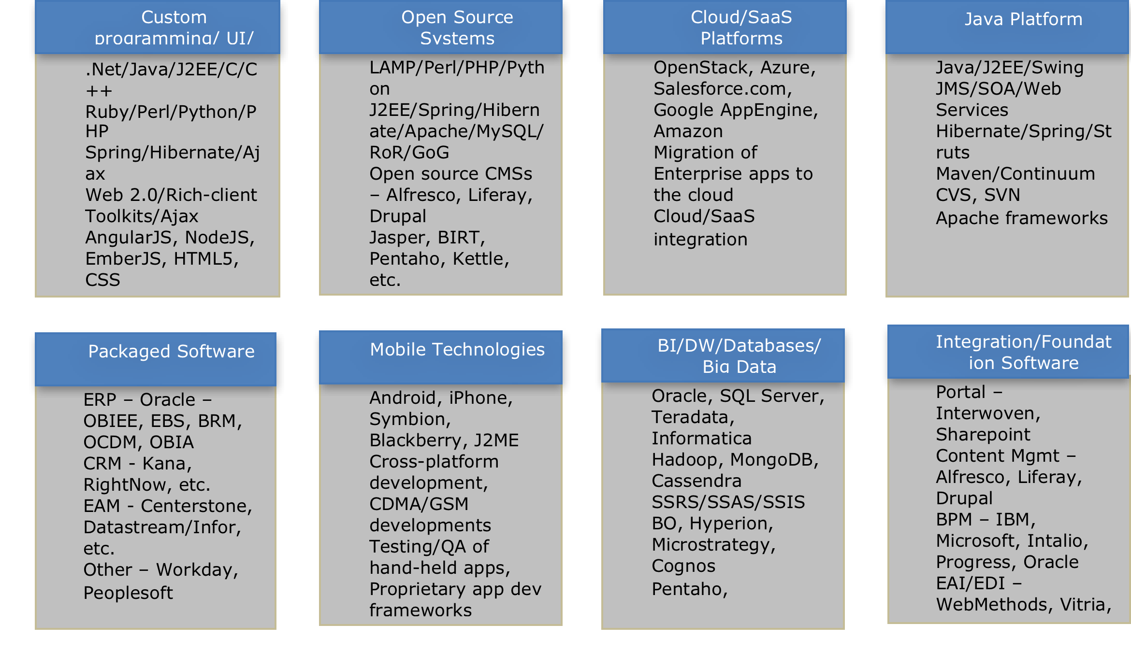
Dev Center | Skillsets

Slide 8
Pending SOW
Owner | Description | Comments | Resources On boarded
Jeremy S | Object Rocket Language Binding | SOW submitted in Nov. | Yes As per Nikki, this can be invoiced
Parichai K | Oracle DBA | SOW submitted on 2/5 | Yes
Greg N | Marketing Acquisition Funnel - CR | CR Submitted on 2/9. As per Greg this is in Contrax | Yes
David M | Rapid Response Team | SOW submitted on 2/19 | Yes
Greg N | SOW for Enterprise Data - CDS Team | Submitted on 3/16 | Yes
Sam Danes | RTB QE | Submitted on 3/25 | Selection in progress
Chris L | CR for PUI SOW | Submitted on 3/24 | Candidate selected. To onboard

Slide 9
Investments
Project | Resource/Team | Rax Owner | Investment | Recurring/ 1Time | Weeks | Time Period | Comments
Investments in Project
BRM | Rajan | Pradip Dhaduk | 15600 | One Time | 3 | April'14 | Investment in initial Kaizen sessions for project scoping
BRM | RJ Kemmel | Pradip Dhaduk | 9000 | One Time | 2.5 | April'14 | Investment in initial Kaizen sessions for project scoping
Object Rocket | 3 member team | Jeremy Scardino | 28800 | One Time | 3 | April - June'14 | 3 Language Bindings done as investment to help prove the model.
QE | Anubha + 1 | Sam Danes | 9600 | One Time | 4 | May - June'14 | Investment to prove the model
Tools Migration/ FDM | Kartheek | Ryan Hawk | 21600 | One Time | 6 | May - July'14 | Investment for FDM and Tools Migration project scoping.
Open Stack | Merryl, Bhavani, 1 more | Product Team | 28800 | One Time | 12 | July'14 - Oct'14 | Working to contribute to Open Stack community
Tools Migration | Tools Migration | Ryan Hawk | 18000 | One Time | - | Sept'14 | Investment in Tools Migration project
Automation - PE | Onsite Team | David Mills | 28160 | One Time | 2 | Oct'14 - Dec'14 | Investment 4 member PE Team
Automation - ARIC | Onsite Team | Clayton Scott | 7600 | One Time | 2 | Sept'14 | Investment 1 BA
Automation - NGAF | Onsite Team | Chris Brown | 7600 | One Time | 2 | Nov'14 | Investment 1 BA
Automation - AI | Onsite Team | Cesar Garza | 15200 | One Time | 2 | Oct'14 - Nov'14 | Investment 1 BA, 1 Cassandra DBA
Automation - ARIC | Dev Center | Clayton Scott | 7680 | One Time | 6 | Nov'14 | Investment 1 Dev Center Resource
Automation - NGAF | Dev Center | Chris Brown | 15360 | One Time | 6 | Nov'14 | Investment 2 Dev Center Resources
Automation - AI | Dev Center | Cesar Garza | 38400 | One Time | 6 | Oct'14 - Nov'14 | Investment 5 Dev Center Resources
ODBC | Satyen | Ryan Hawk | 5600 | One Time | 4 | Oct'14 | Investment in ODBC Project.
Provisioning | Ramesh | Chris LeClair | 63000 | One Time | 29 | May 19 - Nov 9th | Initial discussions, Meeting with various teams, Project kick-off
Provisioning | Kapil | Chris LeClair | 33000 | One Time | 15 | Aug 1 - Nov 13 | Wireframe discussions, team meetings
Provisioning | UI Dev | Chris LeClair | 22800 | One Time | 19 | Aug 1 - Nov 13 | Wireframes, feedback, various screens
Mis. Projects | Karteek |  | 57600 |  | 16 | Sept'14 - Jan'14 | Success of FDM and multiple POC's like Billing Event and related reqms.
Bench, Other
Automation - ARIC | Dev Center | Clayton Scott | 8960 | One Time | - | Sept'14 - Nov'14 | Early Hiring at Dev Center
Automation - NGAF | Dev Center | Chris Brown | 16384 | One Time | - | Sept'14 - Dec'14 | Early Hiring at Dev Center
Automation - AI | Dev Center | Cesar Garza | 52992 | One Time | - | Sept'14 - Nov'14 | Early Hiring at Dev Center
Automation | Dev Center |  | 13440 | One Time | 4 | Aug'14 - Sept'17 | .NET hiring before Tech Change
Fin Data Mart | Rajan | Ryan Hawk | 15600 | One Time | 3 | Sept'14 | Stream-line FDM project when there were product and project management issues
QE | 4 member team | Sam Danes | 38400 | One Time | 8 | Nov'14 - Dec'14 | Bench time
Provisioning | Rest of team | Chris LeClair | 19200 | One Time | 4 | Nov 19 - Dec 15 | Onboarding of 4 member team
Delivery and Technology Enablement
Program Management | DC | Abhishek | 48000 | Ongoing | 12 | Ongoing | Engagement Management
Program Management | Anoop | John | 21600 | - | 6 |  | Engagement Management
Revenue Enablement
Singapore Event |  | One-Time | 30000 | One Time |  | Oct-14
Miscellaneous
Travel |  |  | 35000 |  |  |  | Various Investment travel that icludes Ramesh, Rajan, Karteek etc
TOTAL INVESTMENT |  |  | 732976

Slide 10
Appendix A - Pre-Dev Center | Completed Projects
RAX Needs | Platform | Model | Res Needed | Size (pd) | Size ($) | Partner Investment | Current Stage | Effort Consumed (pd) | Projected Effort Variance | Date of Start | Expected Completion | Comment
ACG Monitoring | AngularJS, Spring WebServices, MySQL, PostgreSQL | Fixed Price | 5 | 200 | 54k | Discovery | Acceptance Pending | 280 | 40.00% | 1 Apr 14 | 2 Jun 14 | - Project handed over with all documentation. Sign-off complete
ACG Monitoring Preferences | AngularJS, Spring WebServices, MySQL, PostgreSQL | Fixed Price | ACG Team | 15 | NA | 10K | Acceptance Pending | 20 | 33.33% | 5 May 14 | 2 Jun 14 | - This is part of ACG Monitoring project
Replatforming Rackspace.com | Drupal | T&M - Staffing | 1 | 40 | 34K | N/A | DEV | 20 | 0.00% | 5 May 14 | 25 Jun 14
ACG Replication | AngularJS, Spring WebServices, MySQL, PostgreSQL | Fixed Price | 5 | 240 | 69k | Discovery | UAT in progress | 390 | 62.50% | 1 Apr 14 | 7-Jul-2014 | - UAT completed, Knowledge - - Transition completed. - Sign off is pending.
QE | Opencafe, Python | Fixed Price | 2 | 40 | NA | 16K | Accepted | 40 | 0.00% | 5 May 14 | 6 Jun 14 | - PoC with Negative testing scenarios along with API test metrics are sent to Vara for evaluation. Accepted
Object Rocket API bindings | JavaScript, PHP, Ruby, Java |  | 6 | 4 Weeks | 35K | 35K | Accepted |  |  |  |  | All the four language bindings has been done and submitted. Working with Jeremy and Nikki for the next SOW
ODP Management Console | Angular JS | Fixed price | 6 | 5 months |  |  | Accepted |  | 10% | 8 Jul 2014 |  | All the sprints are completed. UAT testing is completed and received a confirmation. Knowledge transfer documentation shared with EBI team. Received Signoff from Mike LeJeune

Slide 11
Appendix A - Pre-Dev Center | Completed Projects
RAX Needs | Platform | Model | Res Needed | Size (pd) | Size ($) | Partner Investment | Current Stage | Effort Consumed (pd) | Projected Effort Variance | Date of Start | Expected Completion | Comment
Financial Data Mart - SoW1 | OCDM, OBIA, EBS, BRM | Fixed Price | 11 |  | 300K | Discovery | In Production |  |  | June 14 | Jan 15 | - Project handed over with all documentation. Sign-off complete. Team requested for additional training; discussion with finance team on March 10th to decide training format and next steps
Data Platform work | Informatica, Java, Visual C++ | Fixed Price |  |  | 150K | Technical Spikes | 100% |  |  | Jul 14 | Jan 15 | Confirmation received from Greg on close out of the project.

